Slide 1
Factors Involved in an Anime’s Popularity
A study of the factors involved in a consumer’s score of an anime series
Notes:
Andrew:
Good Afternoon Everyone, we’re group 8. Our group consists of Faadil Ahmed, Tess Foral, Kyle Gwon, Frank Nieto, and Andrew Stranahan. For our project and presentation, we decided to conduct research on anime, or Japanese cartoons.

Slide 2
Introduction
The past few years has seen a recent increase in studies on the growth of the anime industry.
Our work adds to this scholarship through analyzing the factors that influence an anime series’ popularity.
We predict that animes under the shonen or shounen (“teenage boy”) genre will be the most popular.
Notes:
Andrew
Although it might seem strange to conduct a data science project on anime, our work actually comes at an opportune time. For the past few years, there has been a large growth in the appeal and popularity of anime outside of Japan. For example, the film, My Hero Academia: World Heroes’ Mission, received a red carpet premiere on its opening night in the United States. In addition, there has been increased scholarly attention on how to predict the success of future releases from the entertainment industry, including anime. However, while other scholars research factors that affect a film’s or series’ monetary success, we chose to focus on identifying factors that influence an anime series’ popularity.
Popular anime series include My Hero Academia, Demon Slayer, One Piece, Attack on Titan, and Black Clover. Crucially, most popular anime series tend to fall under the shonen / shounen (“teenage boy”) genre. Thus, based on this and on our personal experiences with anime, we predict that animes under the shonen / shounen genre will be the most popular.
Before we discuss how we identified and analyzed the factors that influence an anime series’ popularity, I’ll pass it over to Faadil to share how our work fits in with the research conduct by other scholars.

Slide 3
Literature Review
Many researchers have looked into the popularity of various media (movies, TV shows, etc.) and have looked into the popularity of anime, in particular, based on user-generated data.
One article pulled data from the same dataset as we did.
Other articles described the pros and cons of various machine learning algorithms within Python such as logistic regression and linear regression.
Research conducted by Abidi et al. (2020), Dhir and Raj (2018), and Kanitkar (2018) show that scholars frequently turn to online sources, such as IMDb, to gather data used for running predictive analyses on a movie’s success, prior to running machine learning processes on their collected data.
Notes:
Faadil
Many researchers have looked into the popularity of various media - movies tv shows and more. Typically, these researchers take data from secondhand sources like IMDb and use the aggregated data in machine learning algorithms to predict popularity. (ONE)
Personally, our group used similar methods, taking data from MyAnimeList (a website like IMDb but for anime). Our focus was on the “Overall Score” of each anime, as that was how we defined popularity in our paper. (TWO)
One article (“Prediction of anime series' success using sentiment analysis and deep learning.”) actually pulled data from the same source as we did, so we found that article to be of particular interest. However, the authors of that piece used neural networks to categorize reviews into “positive” and “negative”, which was a bit more complex than our group could really manage. So we took a relatively more simple variable (numerical score) to determine whether people felt positively or negatively about the anime. (THREE)
Other sources examined the benefits and shortcomings of various machine learning Al.
Similarly, AlSulaim and Qamar (2021) applied deep learning methods to process sentiment analysis, and predict an anime series’ success. Meanwhile, Cho et al. (2017) showed that anime consumers want recommendations for new series to watch, but encounter difficulty in finding them. Although each of these scholars used different techniques to uncover their findings, they all collected, normalized, and processed data on either films or anime to predict future popularity and consumers’ interest in their respective media. We modeled our own data analysis of anime based on the research conducted by these scholars.
Having found our own place within recent scholarship, we can now construct our research question: “Can we determine the factors that influence an anime’s popularity using data from an user-generated website?” This research is to determine if it is possible to use similar methods used by previous researchers to determine the popularity of anime among viewers based on a variety of data points and to study what data points might be important when predicting an anime’s popularity.
Based on preliminary knowledge and experience, it seems likely that genre will have an effect on the popularity of a given anime. In particular, animes under the “shounen” (“teen male” - generally characterized as action and adventure) genre will be generally more popular among consumers. (FOUR)
So after full understanding our lit review and grasping a better comprehension of the popularity of anime, Tess will convey our research questions and describe our thought processes.

Slide 4
Research Questions
“Can we determine the factors that influence an anime’s popularity?”
Are more popular genres rated higher or are they similar to the general population?
Are the independent variables correlated? Will our variables be useful in answering our overarching research question?
Are there other indicators of whether or not an anime will be highly rated?
Notes:
Tess
“The overarching question we hoped to answer with our research was ‘Can we determine the factors that influence an anime series’ popularity using user-generated data from an online database?’ We all enjoy anime in this group, so we wanted to see if we could determine what upcoming animes held the potential to blow up in popularity before they actually came out. (This is often done non-scientifically by looking at a variety of factors, wanted to test if there was a reliable way to do so).
As part of our topic, we had to develop a few other research questions before we could answer the overarching one. First, we wanted to see if there was an obvious bias toward the more populated genres (i.e., the genres that had the most anime series), or if they’re generally similar to the population.
Then, we had to test to see if the independent variables would be useful in answering the overarching research question, as highly correlated variables could make our results fairly meaningless.
With all of these questions lined up, we attempted to use a multitude of variables to determine if there was a correlation between any of them and the overall score of an anime series.

Slide 5
Methods
Dataset: Anime Recommendation Database 2020 (Kaggle)
Overarching Platform: Anaconda3
Integrated Development Environment: Jupyter Notebooks 6.2.0
Programming Language: Python 3
Python Libraries:
Pandas
Seaborn
Mathplotlib
Numpy
Statsmodels
Sklearn
Notes:
Tess
We pulled our data from the “Anime Recommendation Database” from Kaggle. This dataset scraped data from a database website specifically for anime called “MyAnimeList”. This dataset contained information like the genre(s) of the anime, the original source material, what studio(s) were involved in production, the overall score users of this website gave the series, and the various lists the users of this websites added the series to.
Pandas -
Read in csv file.
Checking the unique genres and the number of animes associated with each unique genre.
Separate the data into dataframes based on genre.
To do so, we created a Boolean, where if an anime listed a genre, we would give it the designation “1” and if it did not list the genre, it would have a “0.”
Then, every anime that had a “1” in a genre would be added to the genre’s dataframe.
As such, many animes were double counted, but there was no way to determine how strongly the anime aligned with the genre.
Checking Measures of Central Tendency of each dataframe versus the general population.
Seaborn and Mathplotlib -
Visualize measures of central tendency with boxplots.
Show figures.
Numpy -
Calculating odds ratios.
Statsmodels -
To look at summary of Linear Regression.
Sklearn -
To look at summary of Logistic Regression.

Slide 6
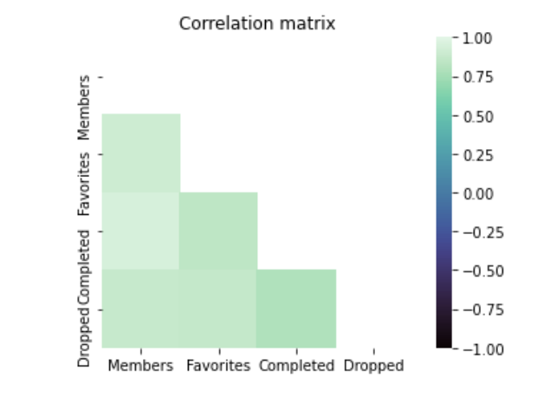
Multicollinearity Results
The variables we chose seem to be quite correlated.
As such, our logistic regression will not necessarily be a reliable source of information.
However, there doesn’t seem to be a correlation between genre and score.
Notes:
Frank
We used pandas to find the correlation.
Variables we are working with:
Genres (not correlated to score).
Episodes, members, favorites (correlated to score).

Slide 7
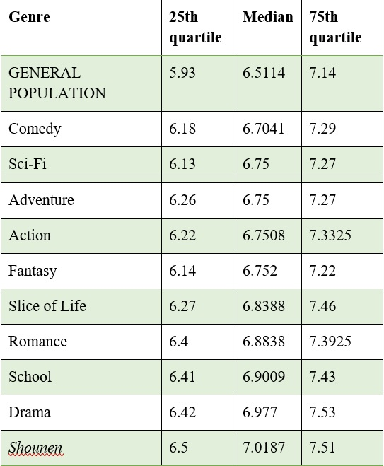
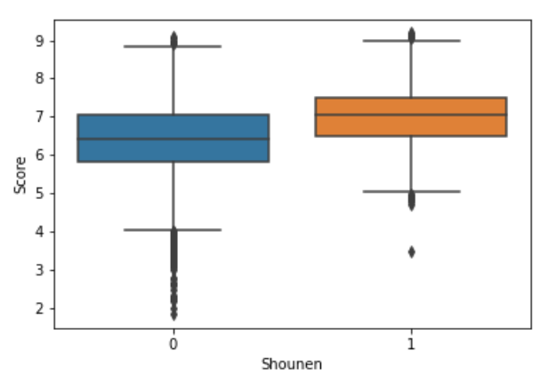

Measures of Central Tendency Results
All of the genres we studied have a median score higher than that of the general population.
The range of the scores of each of the genres tended to be higher as well.
Notes:
Faadil
Genre is categorical data and, as such, difficult to use for prediction.
Once genres were divided into dataframes, we then used the Seaborn package and created box plots against the entire population and used Pandas to calculate each genre’s median score (i.e., median popularity), as well as the 75th and 25th quartile score.
This process was repeated for each genre until all 10 genres had been compared against the population.
There doesn’t seem to be much significance to the genres, and it would be irresponsible to use this data in any predictive senses.
As predicted, the “Shounen” genre is the most highly rated, though more “shoujo” (“teen girl”) genres like “School,” “Romance,” and “Slice of Life” are rated higher than more typical shounen genres of “Action” and “Adventure.” It’s more accurate to say that the Shounen genre is most often rated highly, though genres under that umbrella, like Action and Adventure, aren’t necessarily as highly rated.
The more pop genres tend to be higher rated than the other genres, so Frank will provide a deeper analysis of the correlation between the independent variables.

Slide 8
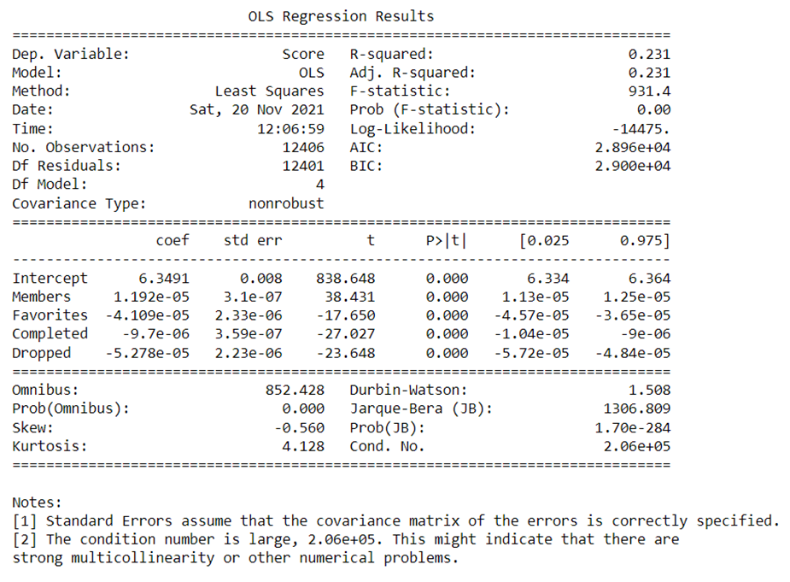
Multivariable Linear Regression Results
Takeaways:
Table 2
Independent Variables: “Members,” “Favorites,” “Completed,” and “Dropped.”
Dependent Variable: “Score.”
We discovered that the relationship among our independent variables and score is weak and confirmed that there is multicollinearity; therefore, we are unable to explain the relationships among our independent variables to our dependent variable.
Notes:
Andrew
One method we took to answering our research question was to run a multivariable linear regression model. Specifically, we used the data from the “Member,” “Favorites,” “Completed,” and “Dropped” columns as our independent variables. Meanwhile, the data from the “Score” column acted as out dependent variable. Although Python and the Statsmodel Module were able to produce an output for our multivariable linear regression model, this statistical method ultimately proved unusable for a few reasons.
First, statistically speaking, our score of r^2 = 0.231 means that the relationship among our independent variables to our dependent variable of “Score” is weak. However, because we are interacting with data based on human behavior, this means that our r^2 value will be low. This makes it hard to gauge the true strength of the relationship among our independent variables to “Score.”
Second, as Frank showed earlier, there is a strong degree of multicollinearity among our independent variables. We received additional confirmation of this after running our multivariable linear regression model, as seen in Note 2 in Table 2. Thus, this issue make running any linear regression analyses invalid because these tests assume no multicollinearity.
All in all, we cannot use multivariable linear regression to predict an anime series’ popularity accurately.
Although we were unable to use multivariable linear regression to analyze our data successfully, I’ll pass it over to Kyle, so that he can talk about another statistical method that we used in our research.

Slide 9
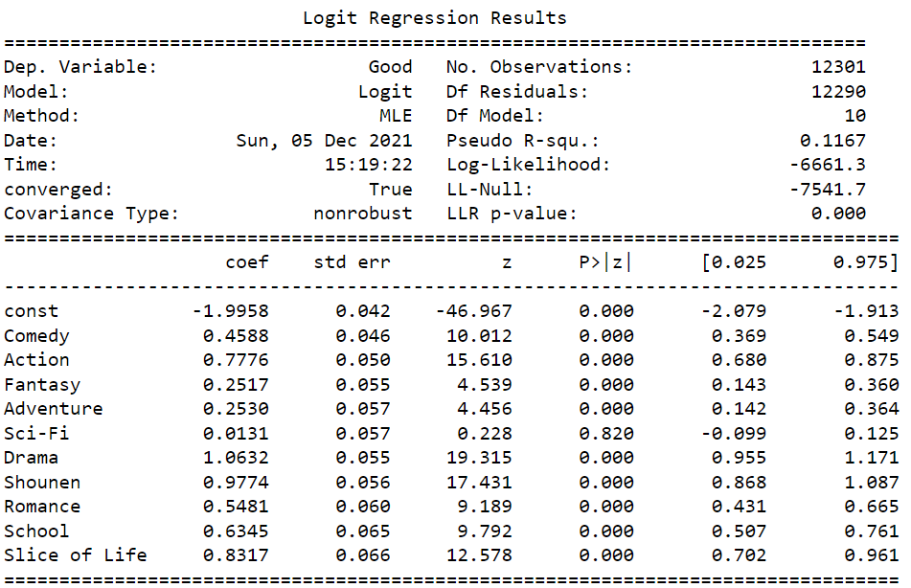
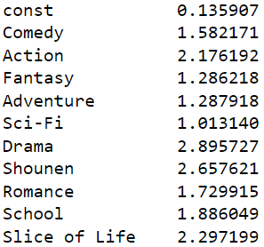
Logistic Regression Results
Takeaways:
Drama genre greater factor than Shounen.
Notes:
Kyle Gwon
We ran a code to find top ten genres that appeared the most and created new columns according to each genres in our dataframe, 1 being present, and 0 being absent.
Because whether a genre is included in a certain title is a binary type of data we could not run a linear regression expecting a reasonable outcome;
When we tried, we got a graph resembling an H which only makes sense as there exists only two values in the independent variable.
And therefore
we found the logistic regression the most appropriate model and made dependent variable the top ten most appeared genres and
The independent variable called “good”, which scored the overall score of 7 and above. And this is the result that surprised us.
There are two takeaways from this regression analysis that, genres alone are not the best factors to describe high scoring animes as the low pseudo R^2 shows.
And from our hypothesis we assumed that the Shounen genre would be the most dominant as success determinant factor, but it isn’t which is shown in the odd ratios.
There are four of the ten genres that has odd ratios higher than 2, and of those Shounen placed in second after Drama.
And now I’ll pass it on to Frank to talk about limitations we experienced from this study.

Slide 10
Limitations
Limitations of the data set:
English language, leaves out other populations.
Self-reported data.
Animes listed under multiple genres.
Lack of more metadata that likely contributes to a series’ popularity:
Social media engagement.
Production budget.
Marketing budget.
Use of popular voice actors/directors/studios.
Our definition of “popularity” might not properly capture true popularity of a series.
Notes:
Frank Nieto
We don’t have access to whether an anime is exclusively sub or dub.
Access: is it on Crunchyroll? Where can it be streamed, ...piracy?

Slide 11
Future Work
Gathering data on some of the metadata that exists about these shows and compiling them into a database.
Examining how fan content affects popularity.
i.e., do fanworks contribute to or detract from official media?
Determine how fans engage with content.
Notes:
Kyle Gwon
Future work would include gathering and analyzing more metadata of these shows, and examining how secondary creation affects popularity and how fans interact with them.
If I personally learned anything from this analysis I found very few titles with just one or two genres. That is, we shouldn’t look at genres as an independent and unique factors but we should consider them as building blocks of genre combinations.
For example, from our logistic regression analysis we saw “Drama” having the highest odd ratio but it also contains such dramatic range of characteristics to describe it and; hence, the flexibility to be combined with other genres. And that was our assumption as to why it was able to have higher odd ratio than Shounen genre.
And so, if we were to expand our research, we could study regression analysis on genre combinations and popularity.

Slide 12
Conclusion
None of the factors listed meaningfully contributed to a series’ overall score.
The results we did find are most likely casual in nature rather than correlational.
Notes:
Kyle Gwon
Finally, to answer our research question, none of the factors, both given and derived from this dataset, contributed a meaningful values to measure or predict a success of anime series.
And, therefore, we find this dataset to be more applicable in a casual use rather than correlational analysis.
Our research question, however, still seems valid and important to understand both to consumers and workers of entertainment industry to further understand the trend.
As for consumers, we should determine the factors that introduce and prolong the interest of the current viewers.
And as for entertainment workers, understandably, it is difficult to produce new creation every time.
This study can provide them better understanding of the current market, and avoid producing less cliched and more original contents.
This is our conclusion of our research presentation and thank you for tuning in.
And for future references, the literatures we used in our study are available in the next slide.
Are more populated genres rated higher or are they similar to the general population?
Are the independent variables correlated? Will our variables be useful in answering our overarching research question?
Are there other indicators of whether or not an anime will be highly rated?
Are more populated genres rated higher or are they similar to the general population?
Are the independent variables correlated? Will our variables be useful in answering our overarching research question?
Are there other indicators of whether or not an anime will be highly rated?

Slide 13
References
Abidi, S. M., Xu, Y., Ni, J., Wang, X., & Zhang, W. (2020). Popularity prediction of movies: From Statistical Modeling to Machine Learning Techniques. Multimedia Tools and Applications, 79(47-48), 35583–35617.
AlSulaim, S. M., & Qamar, A. M. (2021). Prediction of anime series' success using sentiment analysis and deep learning. 2021 International Conference of Women in Data Science at Taif University (WiDSTaif ).
Anaconda, Version 3.9, Austin, TX
Cho, H., Schmalz, M. L., Keating, S. A., & Lee, J. H. (2017). Information needs for anime recommendation: Analyzing anime users' online forum queries. 2017 ACM/IEEE Joint Conference on Digital Libraries (JCDL).

Slide 14
References
Dhir, R., & Raj, A. (2018). Movie success prediction using machine learning algorithms and their comparison. 2018 First International Conference on Secure Cyber Computing and Communication (ICSCCC).
Hodgkins, C. (2019, June 9). JMPA reveals manga magazine circulation numbers for January to March 2019. Anime News Network. https://www.animenewsnetwork.com/staff
Kanitkar, A. (2018). Bollywood movie success prediction using Machine Learning Algorithms. 2018 3rd International Conference on Circuits, Control, Communication and Computing (I4C).
Python, Version 3.10.01, Beaverton, OR

